Slide 1

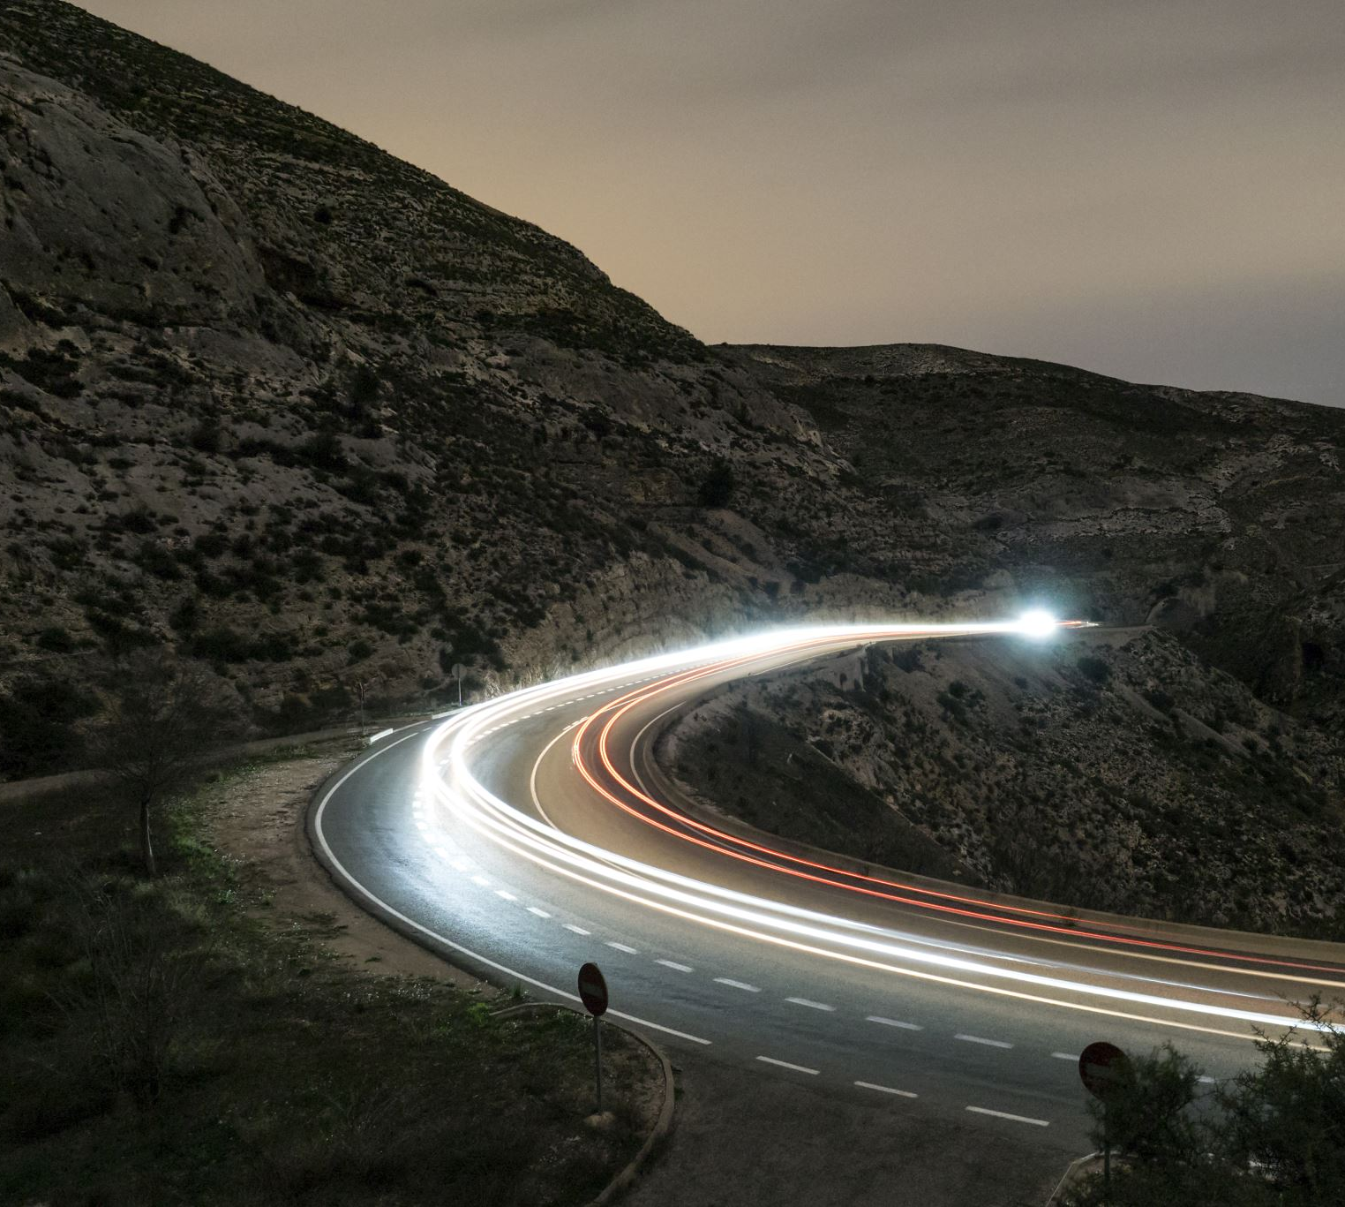
Texas Traffic Accident Patterns in 2018
Monica Bustillos
Bobby Del Bosque
Courtney Gomez

Slide 2
What is the best environment in San Antonio to mitigate the chances of being in an accident?
Where ?
Does zip code matter?
Does population matter?
Does side of town matter?
When?
Does time of day matter?
Does part of month matter?
Does month matter?
Weather?
Does weather condition matter?
Does amount of precipitation matter?
Does visibility matter?

Slide 3

Data Cleanup and Exploration

Slide 4
Data Cleanup
Full Dataset: US Accidents (4.2 million records)
Source: https://www.kaggle.com/sobhanmoosavi/us-accidents
Description: Reported accidents over US from 2016-Dec 2020, includes location of accident, date of the occurrence, weather at time of the accident, and other variables.
Data Extrapolated: Accidents that occurred in Texas in 2018, including the weather, location and time of occurrence.
Cleaned Dataset: cleaned_2018_texas_accidents.csv

Slide 5
Data Exploration
Insights:
Change of questions to fit core question
Needed additional data for location question
Problems:
Size of Dataset
Dropped empty rows
Time column – as date

Slide 6
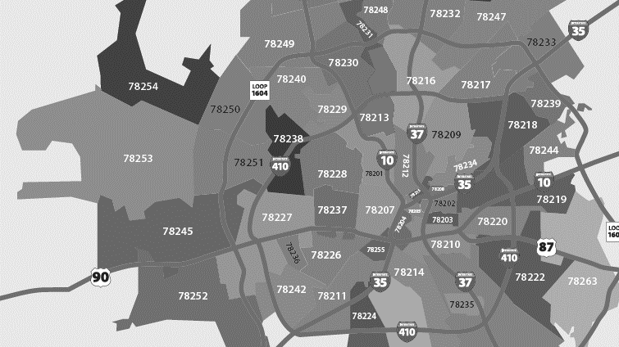
Where is the best place to drive in San Antonio?

Slide 7
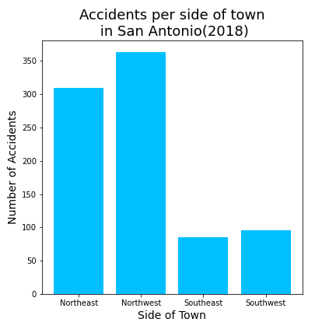
Accidents by Side of Town

Slide 8
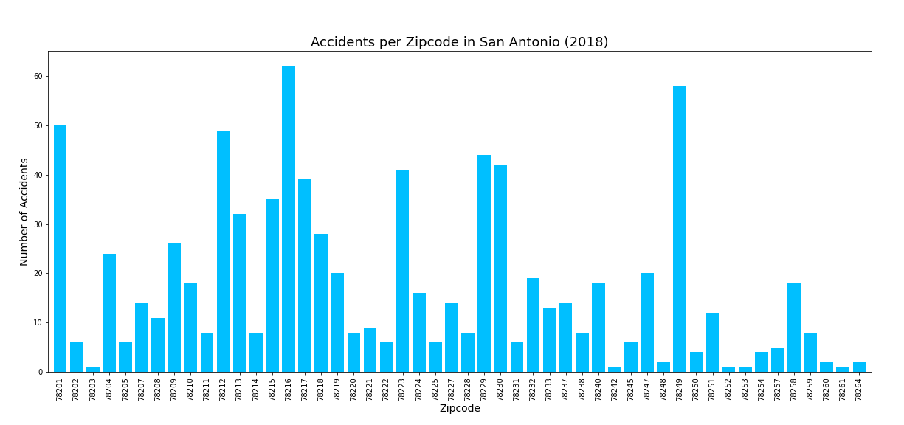
Zip Code Analysis
Number of Accidents in each zip code in San Antonio

Slide 9
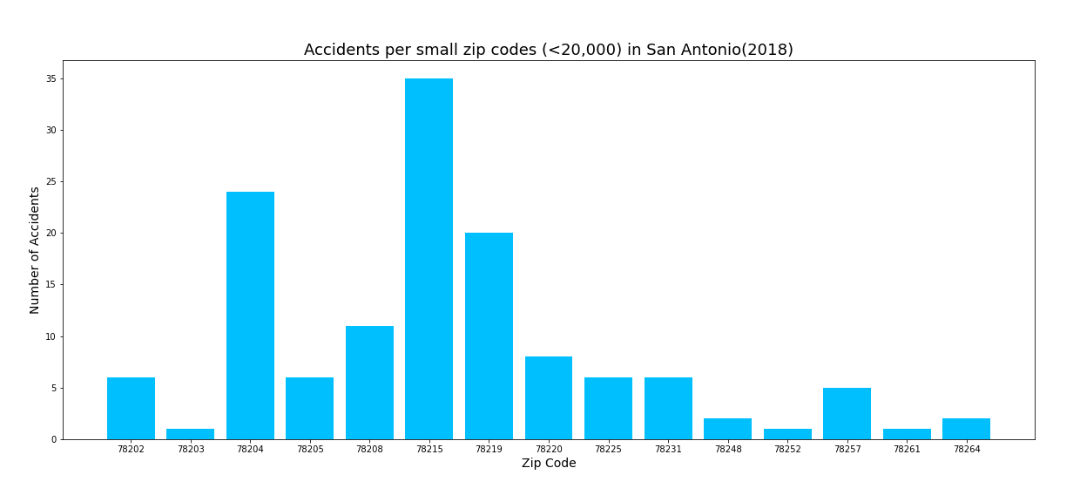
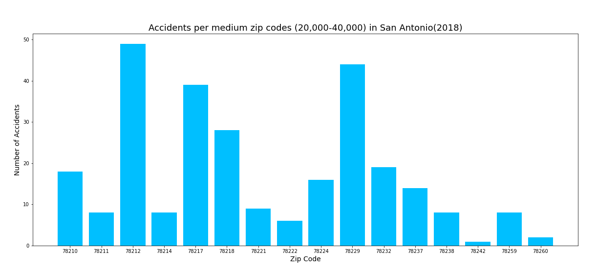
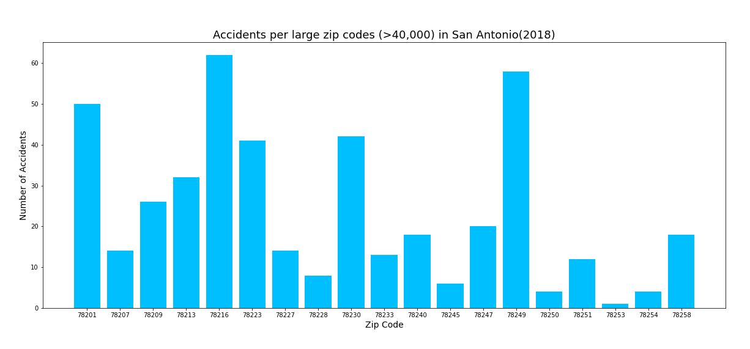
Small Zip Codes (population of less than 20,000)
Medium Zip Codes (population of 20,000-40,000)
Large Zip Codes (population of more than 40,000)

Slide 10
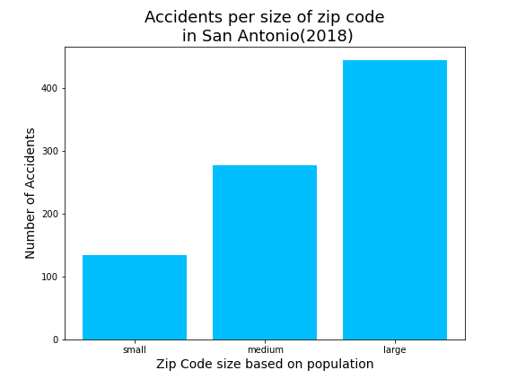
Total Accidents by Zip Code Population
Hypothesis: The areas with the higher populations will have more accidents.

Slide 11
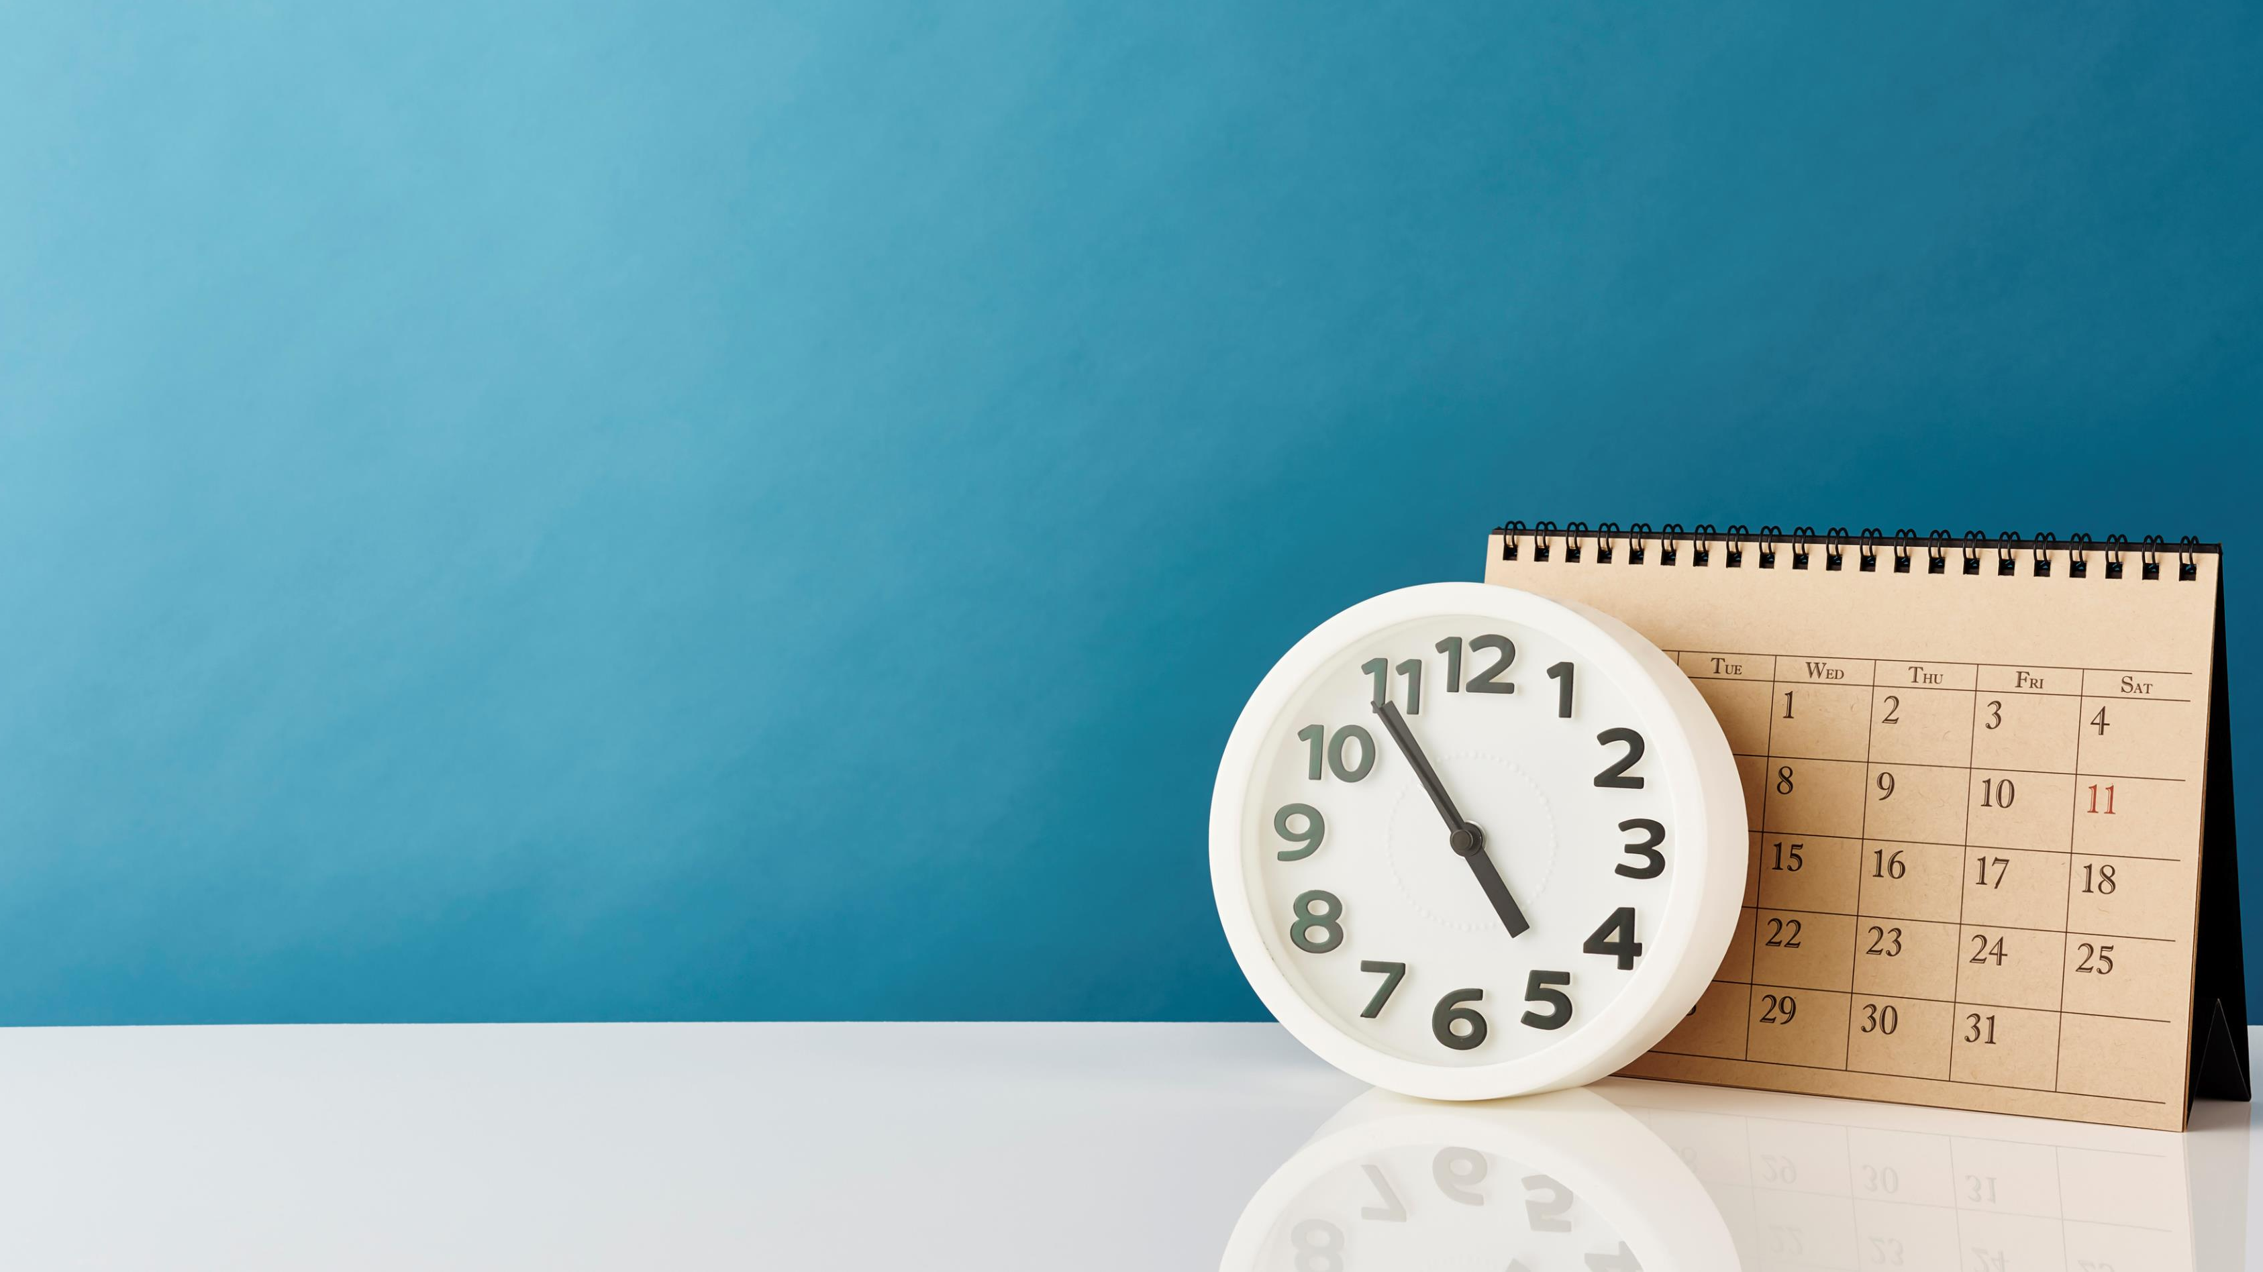
When is the best time to drive in San Antonio?

Slide 12
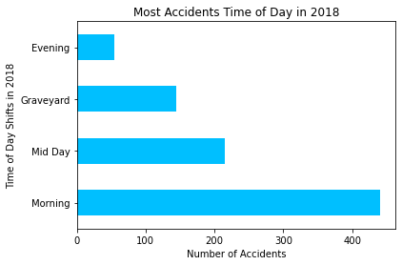
Accidents by Time of Day
Hypothesis: There will be more accidents during rush hour, when people are heading home from work.

Slide 13
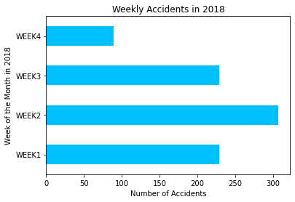
Accidents by Week of Month

Slide 14
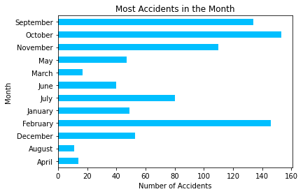
Accidents by Month

Slide 15
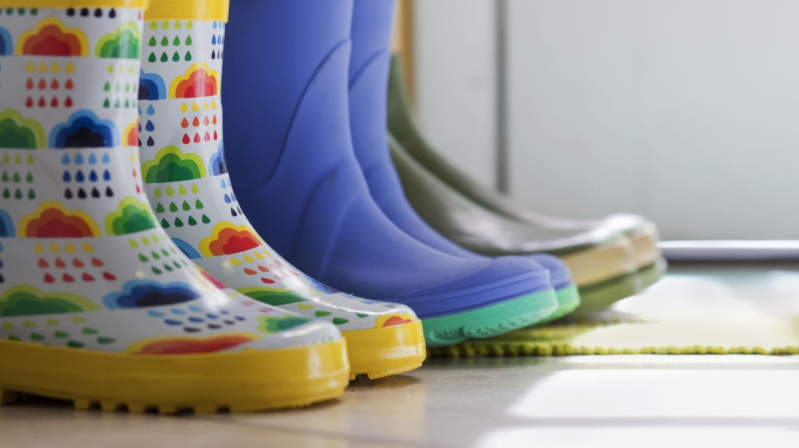
What is the best weather to drive in San Antonio?

Slide 16
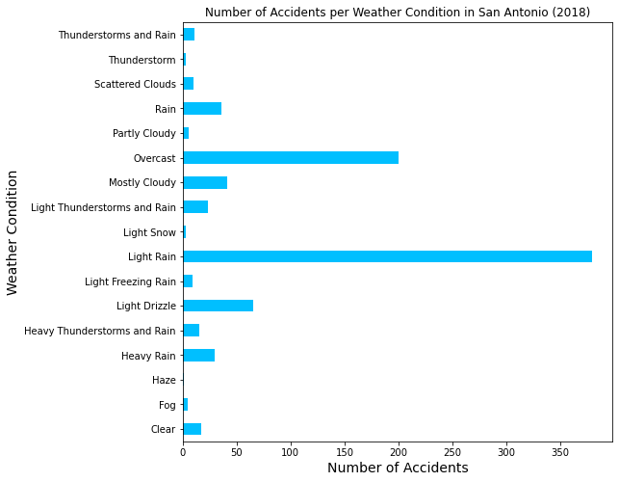
Accidents by Weather Condition

Slide 17
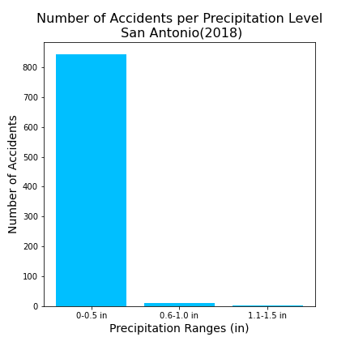
Accidents in Precipitation
Hypothesis: The more water on the ground, the more accidents will occur.

Slide 18
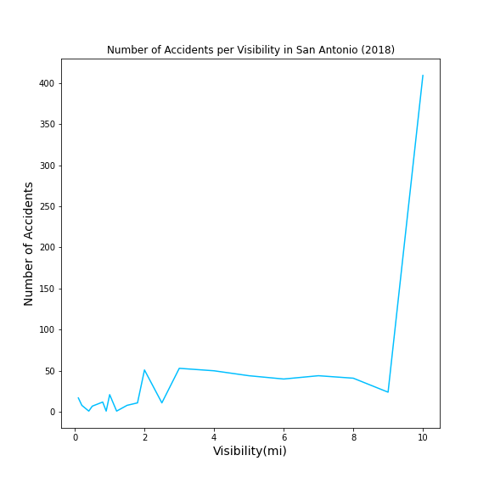
Accidents per visibility conditions

Slide 19

What’s next?

Slide 20
Additional research questions…
Is there any correlation between weather and location?
Is there any correlation between weather and time?
Is there any correlation between location and time?

Slide 21
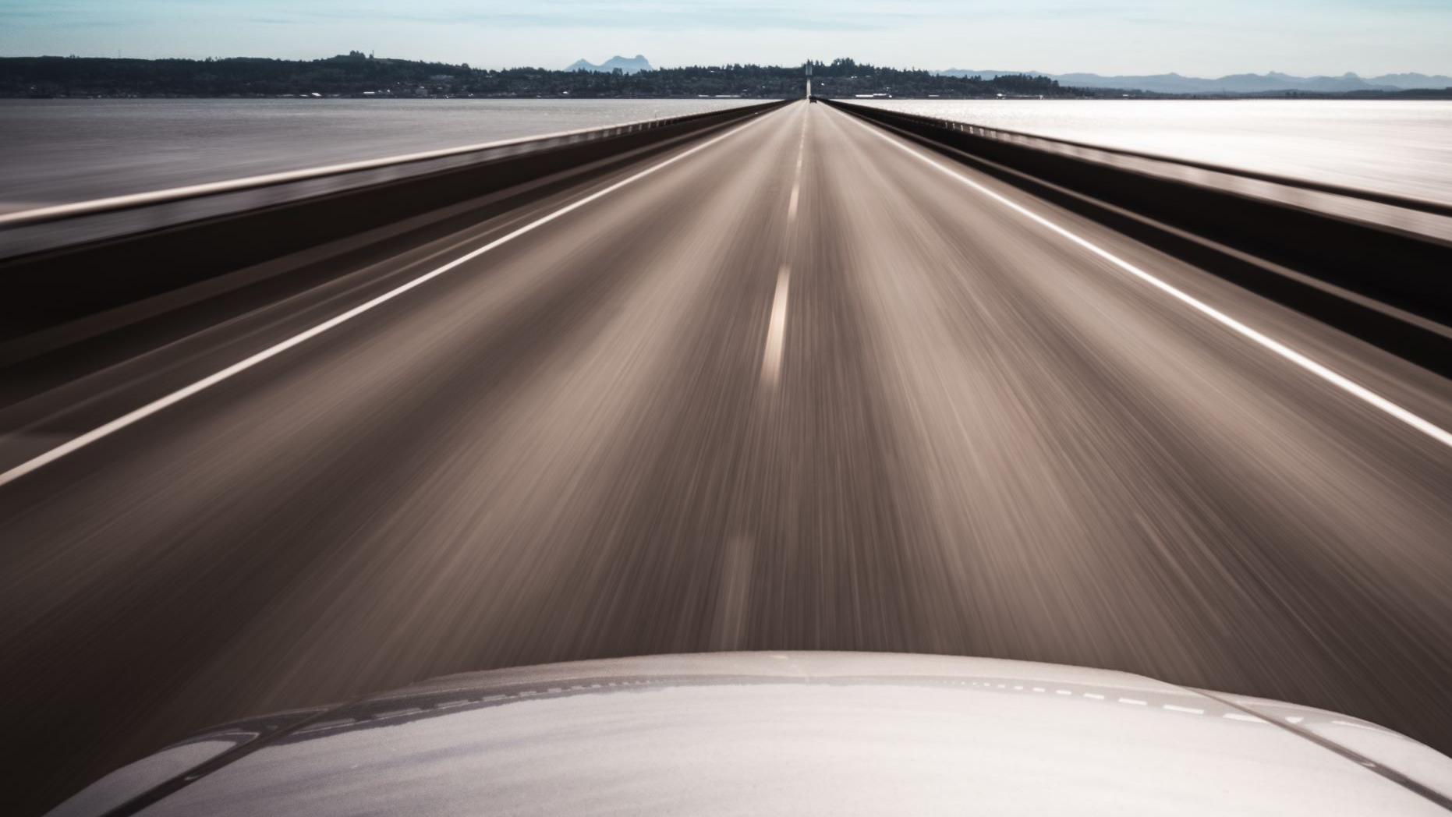
Where and when to drive in San Antonio

Slide 22
To reduce your chances of getting into an accident in San Antonio, you should drive……
in the Southeast part of town, specifically in zip code 78203,
between 6pm -12am in week four of August,
while it is clear or partly cloudy.

Slide 23
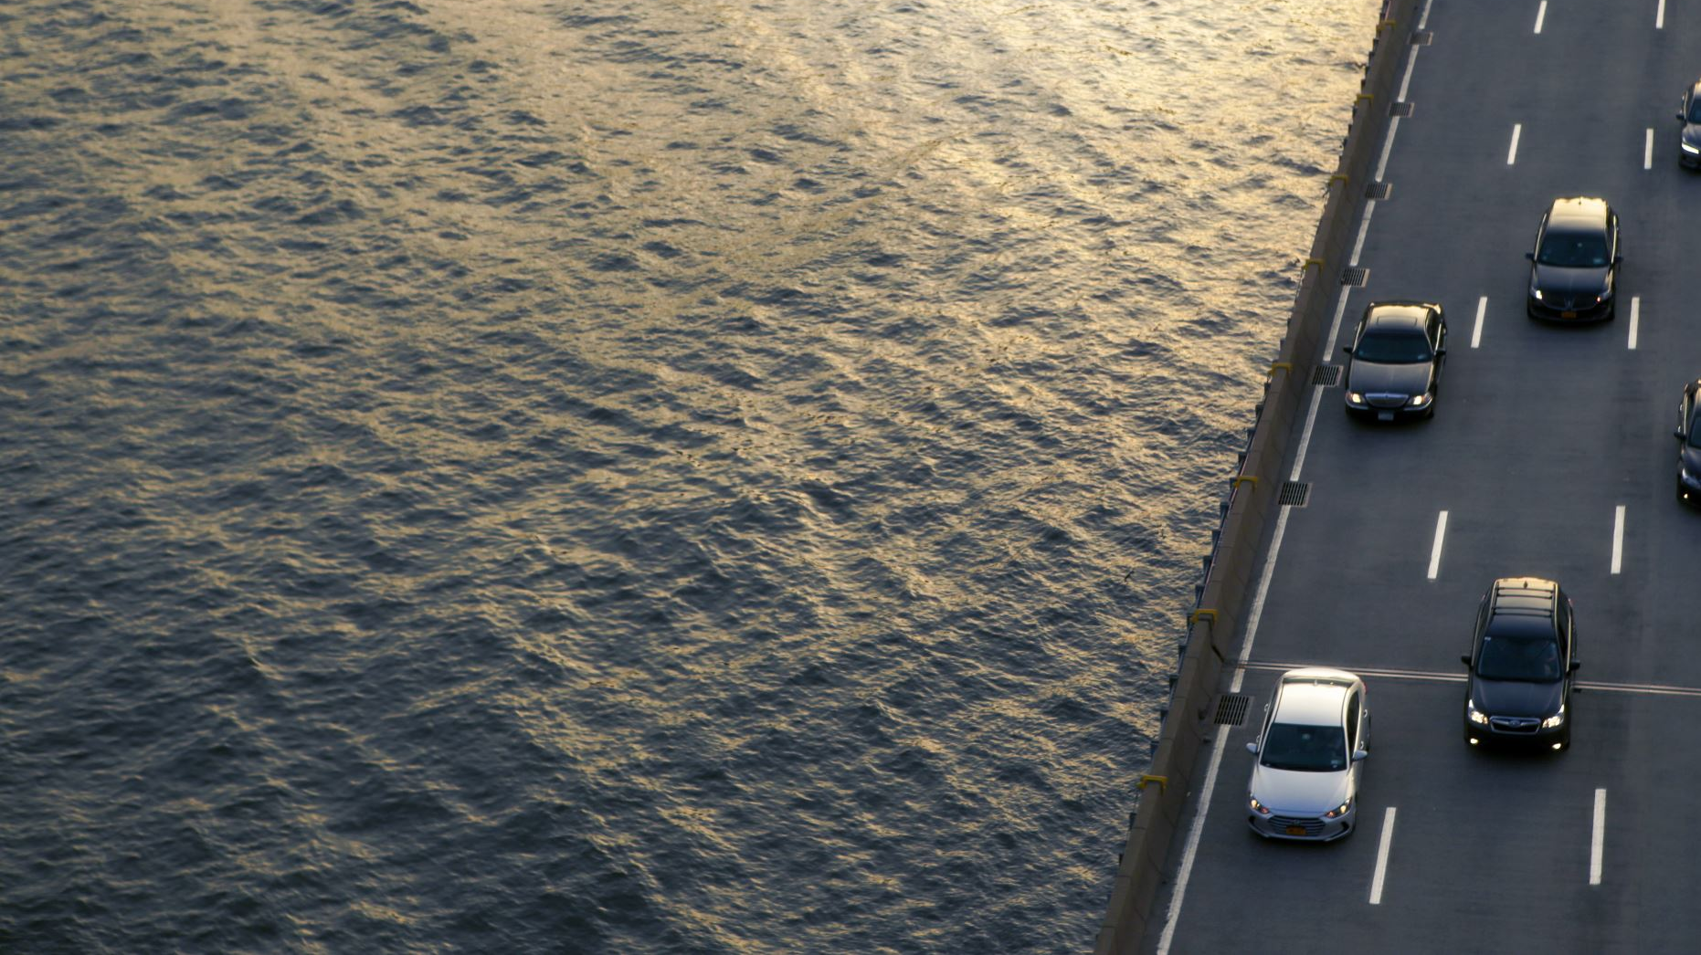
Happy Driving!

